Slide 1

Analysing Tartu Smart Bike usage data 2019-2021
Aleksander Tamm & Martin Vendelin
Tartu 2021

Slide 2
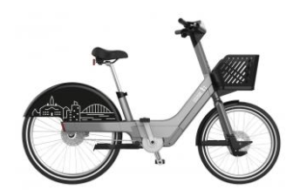
Introduction
Data of 1.7 million rides
Containing start and end time and location, length and riders age
From “the beginning” 2. June 2019 to 30. April 2021

Slide 3
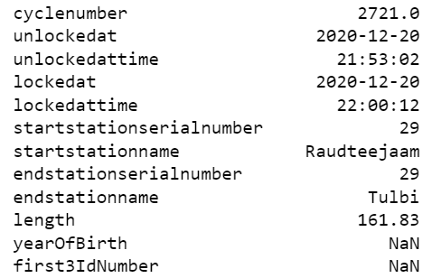
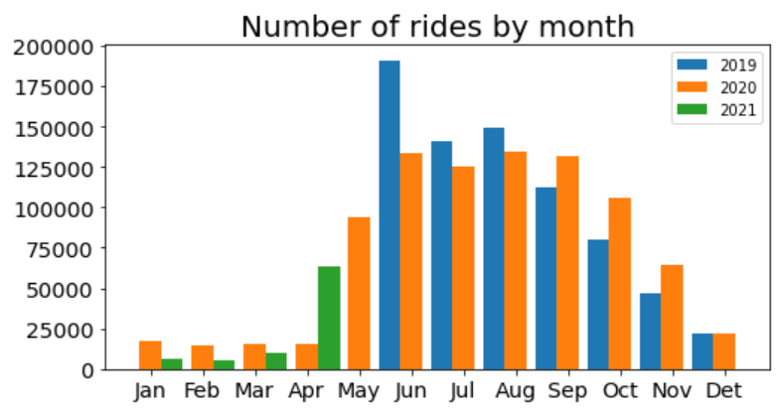
Problems
Broken data- we spent 2 days cleaning data
After cleaning only ~1 mil rides were totally clean( its 60%)
Good example- right
Can’t predict 2022 usage because given data doesn’t cover full year
Lack of data overlapping by year- left

Slide 4
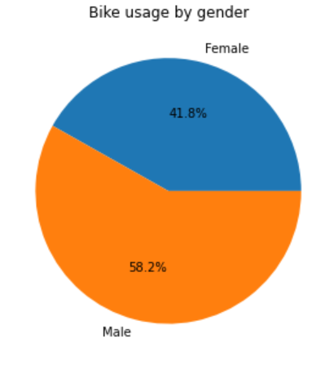
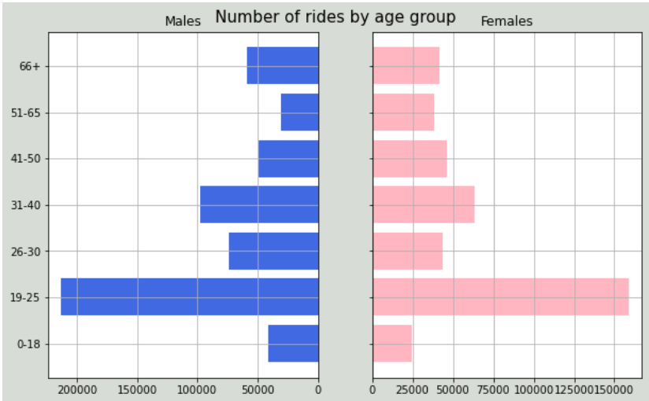
What we found?
Most users are male
Most users are young, but chances are that your grandma rides too

Slide 5
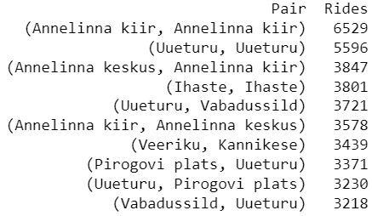
What else?
10 most favourite start and end station pairs (left):
Based on same start and end station:
People like to leave bikes reservated for them in front of shops
Bikes are good way to run quick errands
Average speed of rides is 11.6 km/h
And average ride is 2.81 km- its > 4euros with taxi
Total distance 4.46 million km

Slide 6
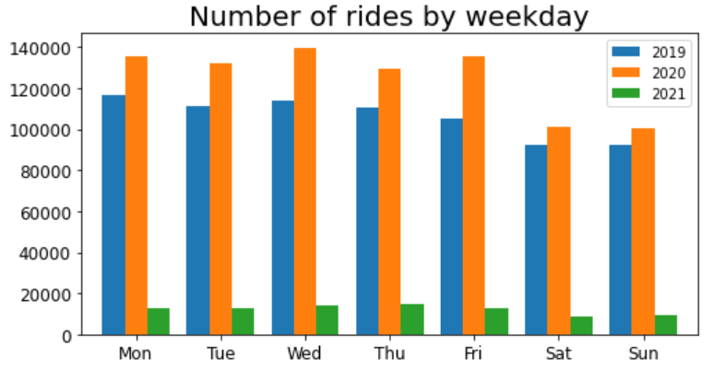
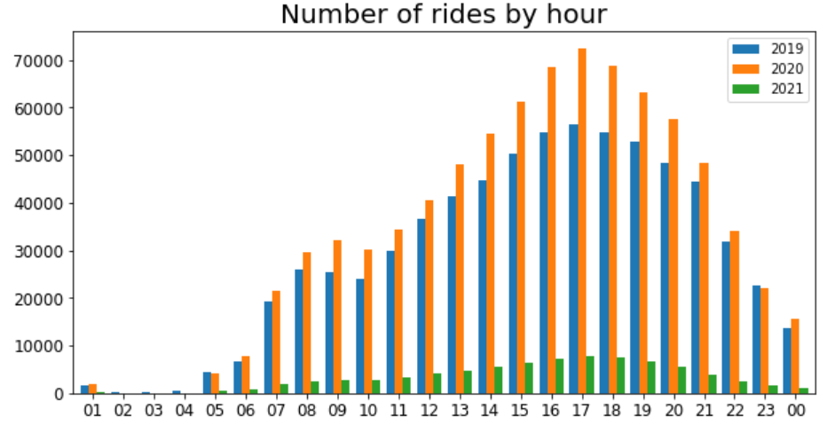
Habits of riders
Interestingly going to school/work isn’t most popular time to use bikes
Even at weekends bikes are very popular

Slide 7
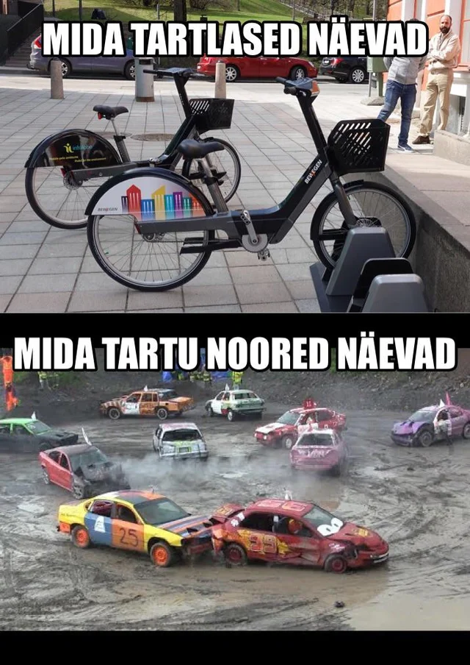
Conclusion
Perfect data to learn data cleaning and statistics
We underestimated how much work cleaning data is
Based on id and birth year difference- lot of users lie about their age
Although we didn’t use machine learning
we definitely learned the first part of the course

